Slide 1
Web Interface part 2
Complied by -- Ms. Rushita Verlekar
BCA

Slide 2
topics
Meta tags
Table elements
Form elements

Slide 3
Meta tags
The <meta> tag defines metadata about an HTML document. Metadata is data (information) about data.
<meta> tags always go inside the <head> element, and are typically used to specify character set, page description, keywords, author of the document, and viewport settings.
Metadata will not be displayed on the page, but is machine parsable.
Metadata is used by browsers (how to display content or reload page), search engines (keywords), and other web services.

Slide 4
<meta> tag
Define keywords for search engines:
<meta name="keywords" content="HTML, CSS, JavaScript">
Define a description of your web page:
<meta name="description" content="Free Web tutorials for HTML and CSS">
Define the author of a page:
<meta name="author" content="John Doe">
Refresh document every 30 seconds:
<meta http-equiv="refresh" content="30">
Setting the viewport to make your website look good on all devices:
<meta name="viewport" content="width=device-width, initial-scale=1.0">
This gives the browser instructions on how to control the page's dimensions and scaling.
The width=device-width part sets the width of the page to follow the screen-width of the device (which will vary depending on the device).
The initial-scale=1.0 part sets the initial zoom level when the page is first loaded by the browser.

Slide 5
Example of <Meta> tag
<!DOCTYPE html>
<html>
<head>
<meta charset="UTF-8">
<meta name="description" content="Free Web tutorials">
<meta name="keywords" content="HTML,CSS,XML,JavaScript">
<meta name="author" content="John Doe">
<meta name="viewport" content="width=device-width, initial-scale=1.0">
</head>
<body>
<p>All meta information goes in the head section...</p>
</body>
</html>

Slide 6
This codewill refresh the page in 5 seconds
<!DOCTYPE html>
<html>
<head>
<title>Meta Tags Example</title>
<meta http-equiv = "refresh" content = "5" />
</head>
<body>
<p>Hello HTML5!</p>
</body>
</html>

Slide 7
This code will redirect the page to the link mentioned in the url in 5 seconds
<!DOCTYPE html>
<html>
<head>
<title>Meta Tags Example</title>
<meta http-equiv = "refresh" content = "5; url = http://www.tutorialspoint.com" />
</head>
<body>
<p>Hello HTML5!</p>
</body>
</html>

Slide 8
Table
HTML tables allow web developers to arrange data into rows and columns.
<table> --- defines an HTML table.
<tr> -- table row
<th> -- table header (by default : bold and centered)
<td> -- table data/cell (by default : regular and left-aligned)

Slide 9
<table> Tag Attributes
border
border="n" specifies thickness of border in n pixels
border="0" means no border for the table. This is the default setting for border
bordercolor
Specifies the colour of the table border
width and height
Specifies the width and height respectively of the table in pixels or as a percentage

Slide 10
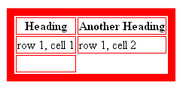
Example – Table Attributes, Headings, Empty Cells
<html>
<head><title>Tables</title></head>
<body>
<table border="10" bordercolor="red">
<tr>
<th>Heading</th>
<th>Another Heading</th>
</tr>
<tr>
<td>row 1, cell 1</td>
<td>row 1, cell 2</td>
</tr>
<tr>
<td>&nbsp;</td>
<td></td>
</tr>
</table> </body>
</html>

Slide 11
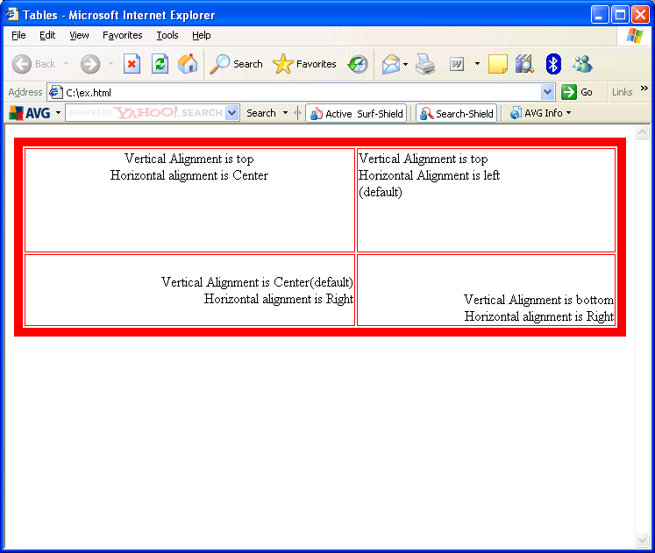
Align Content in Table/Cells
<html>
<head> <title>Tables</title> </head>
<body>
<table width=100% height=50% border="10" bordercolor="red">
<tr valign="top">
<td align="center">Vertical Alignment is
top<br> Horizontal alignment is Center
</td>
<td>Vertical Alignment is top<br>
Horizontal Alignment is left<br>(default)
</td>
</tr>
<tr align="right">
<td>Vertical Alignment is Center(default)<br>
Horizontal alignment is Right
</td>
<td valign="bottom">Vertical Alignment is
bottom<br> Horizontal alignment is Right
</td>
</tr>
</table> </body> </html>

Slide 12
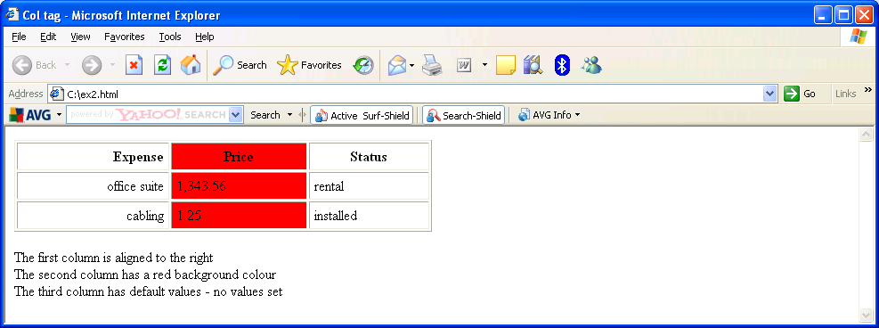
Example - <col> Tag
<html>
<head><title> Col tag</title></head>
<body>
<table border cellpadding="5"
width="50%">
<col align="right"></col>
<col bgcolor="red"></col>
<col></col>
<tr> <th>Expense</th> <th>Price</th> <th>Status</th> </tr>
<tr> <td>office suite</td> <td>1,343.56</td> <td>rental</td> </tr>
<tr> <td>cabling</td> <td>1.25</td> <td>installed</td> </tr>
</table>
<p> The first column is aligned to the right<br>The second column has a red background colour<br>The third column has default values - no values set</p>
</body>
</html>

Slide 13
Forms
A form is an area that contains form elements
HTML forms are used to create (rather primitive) GUIs on Web pages
The purpose is to obtain information from the user
The information is then sent back to the server
The syntax is:
<form parameters> ...form elements... </form>
parameters tell how the information is to be sent to the server
elements include buttons, checkboxes, text fields, radio buttons, drop-down menus, etc.
A form usually contains a Submit button to send the information in the form elements to the server
Other HTML tags can be mixed in with the form elements

Slide 14
Form - Attributes
action=“url” (required)
Specifies where to send the data when the Submit button is clicked
method=“get” (default)
Form data is sent as a URL with ?form_data appended at the end
Can be used only if data is all ASCII and not more than 100 characters
method=“post”
Form data is sent in the body of the URL request
Sent as a separate packet to the HTTP server
target=“target”
Tells where to open the new page sent back as a result of the request
_blank - Opens in a new window
_self - Response is loaded in the same window that contains the form
_parent - Loads in parent window. Used when the form is in a frame The response is loaded in the parent frame
_top - Loads in the top most window. Used when the form is in a frame
autocomplete='on ' or ‘off’
id='idf’
novalidate='novalidate'

Slide 15
Form Elements - <input> Tag
The kind of input is specified with the type attribute
type attribute can take the following values :
text (for text fields) | submit (submit button)
radio (for radio buttons) | reset (reset button)
checkbox (for checkboxes) | hidden (hidden data)
password (for password data) | button
file | image
We will look at each of these in the later slides.

Slide 16
Input – Other attributes
name
A unique name required to be given to each input element.
size
Indicates the size of the text box
Optional attribute
maxlength
Maximum number of characters and digits that can be typed into the box.
In most browsers, the width of the text field is 20 characters by default.
Optional attribute

Slide 17
Input – Other attributes
value
Sets an initial value for the field
Used in different ways for different values of type attribute
readonly
The value cannot be changed.
disabled
The user can’t do anything with this element
Other attributes are defined for the <input> tag but have meaning only for certain values of type attribute

Slide 18

Input Attribute – type="text"
Text fields are used when you want the user to type letters, numbers, etc. in a form.
TEXT is the default input type (if you want a text field, you don't even need to use the TYPE attribute).
A text field:
<input type="text" name="textfield" value="with an initial value">

Slide 19
Input Attribute – type="submit"
Used to add a submit button to the form
When clicked, the submit button triggers the browser to send the data in the form to the server
Syntax
<INPUT TYPE="SUBMIT" NAME="name" VALUE="label">
NAME ="name"
This attribute is to identify the submit button
There can be more than one submit buttons in a form. The server identifies which submit button was clicked by using the NAME attribute
VALUE="label"
The string given in the VALUE attribute is displayed as the label of the submit button in the form.

Slide 20
Example - type="text" and type="submit"
<HTML>
<HEAD><TITLE>HTML form tutorial example</TITLE></HEAD>
<BODY>
<H1>HTML form tutorial example</H1>
<FORM ACTION="ex1.html" METHOD=“GET">
Name: <INPUT TYPE="TEXT" NAME="Name" VALUE="" SIZE="25" MAXLENGTH="50"> <BR>
Email: <INPUT TYPE="TEXT" NAME="Email" VALUE="" SIZE="25" MAXLENGTH="50"><BR>
<INPUT TYPE="SUBMIT" NAME="submit" VALUE="Sign Me Up!">
</FORM>
</BODY>
</HTML>

Slide 21
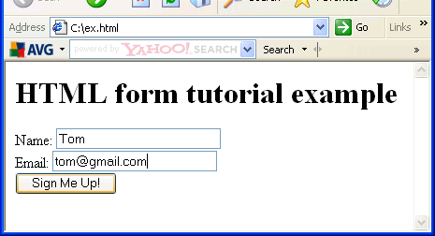
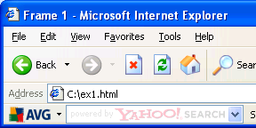
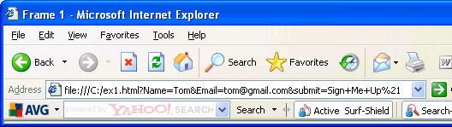
Form and Its Posting
Form with textboxes and Submit button
Output with POST
Output with GET

Slide 22
Input Attribute – type="checkbox"
Creates a checkbox which can be either ON (checked) or OFF (unchecked)
Used when you want the user to select one or more options from a list
The default state of checkbox is OFF. If you want the checkbox initially ON, use the CHECKED attribute
Values of checked checkboxes are sent to the server; if they are OFF, no values are sent

Slide 23
Input Attribute – type="checkbox"
Checkbox code:
<input type="checkbox" name="cbox” value="checkbox” checked>
type: "checkbox"
name: used to reference this form element
value: value to be returned when element is checked
Note that there is no text associated with the checkbox—you have to supply text in the surrounding HTML

Slide 24
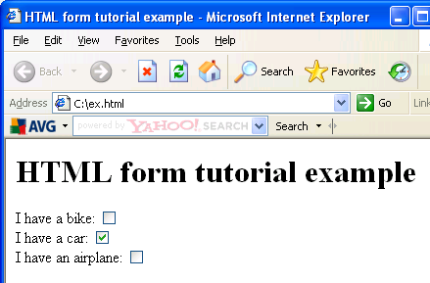
Example - Checkbox
<html>
<head><title>HTML form tutorial example</title></head>
<body>
<h1>HTML form tutorial example</h1>
<form>
I have a bike:
<input type="checkbox"
name="vehicle" value="Bike" /><br/>
I have a car:
<input type="checkbox"
name="vehicle" value="Car" /><br/>
I have an airplane:
<input type="checkbox"
name="vehicle" value="Airplane" />
</form>
</body></html>

Slide 25
Input Attribute – type="radio"
Used to create a series of choices of which only one can be selected.
A set of radio buttons are created by using several <input type="radio"> tags, all with the same name, but with different values.
The content of the VALUE attribute is sent to the server
If one of the items should be the default selection, use the CHECKED attribute

Slide 26
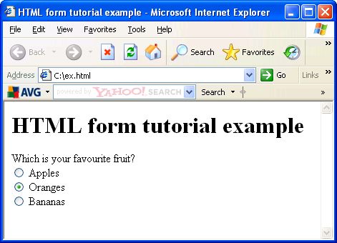
Example – Radio buttons
<HTML>
<HEAD><TITLE>HTML form tutorial example</TITLE></HEAD>
<BODY>
<H1>HTML form tutorial example</H1>
<form>
Which is your favourite fruit?<br>
<input type="radio" name="fav" value="apples"> Apples<br>
<input type="radio" name="fav"
value="oranges"> Oranges<br>
<input type="radio" name="fav"
value="bananas"> Bananas<br>
</form>
</BODY>
</HTML>

Slide 27
Input Attribute – type="password"
Works just like a TEXT type field, with the difference that whatever is typed is not displayed on the screen.
The browser displays a series of asterisks (*) or bullets (·)
PASSWORD fields are not sent encrypted, they are sent in the same manner as all the other elements on the form
When you use PASSWORD, you should set the form METHOD to POST. Why?

Slide 28
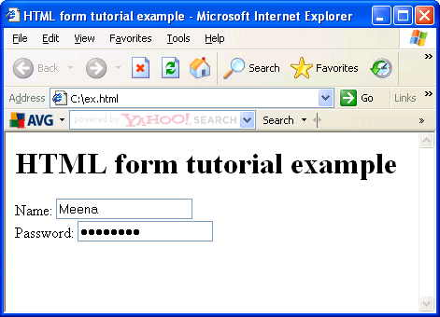
Example - Password
<html>
<head><title>HTML form example</title></head>
<body>
<h1>HTML form tutorial example</h1>
<form>
Name:
<input type="text"
name="realname"><br>
Password:
<Input type="password"
name="mypwd">
</form>
</body></html>

Slide 29
Input Attribute – type="hidden"
The field becomes invisible and the user never interacts with it.
The field is still sent to the server, and scripts can also use the hidden field.
The value of a hidden field can be set programmatically, before the form is submitted.
<input type="hidden" name="hiddenField" value=“hide"> &lt;-- right there, don't you see it?

Slide 30

Input Attribute – type="reset"
Resets the form to its initial unfilled state
Designers have found that resets are more likely to detract from the form than add to it.
Users are more likely to accidentally hit the reset button and wipe out their work.
Unless users specifically need a reset button, it's probably best to leave it out.
If a reset button is provided in your form, consider adding a check if the user actually wants to reset.

Slide 31
Input Attribute – type="button" and type="file"
If you were programming in JavaScript, you might find <input type="button"> is useful.
It creates buttons that do not submit the form, but rather can perform a JavaScript action.
file is used for doing file uploads in a form.
File uploads are a relatively new and still not well-standardized type of form input.
File uploads allow you to send an entire file from your computer to the web server as part of your form input.

Slide 32
Input Attribute – type="image"
Creates an image that is also a "submit" button.
When the user clicks on the image, the form is submitted.
All the attributes of <IMG> tag also work with the <input type="image"…>
The syntax is as follows:
<input type="image" src="graphic_URL" alt="Submit!">

Slide 33
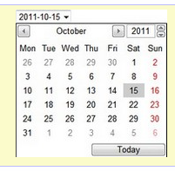
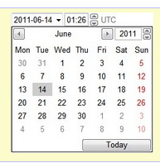
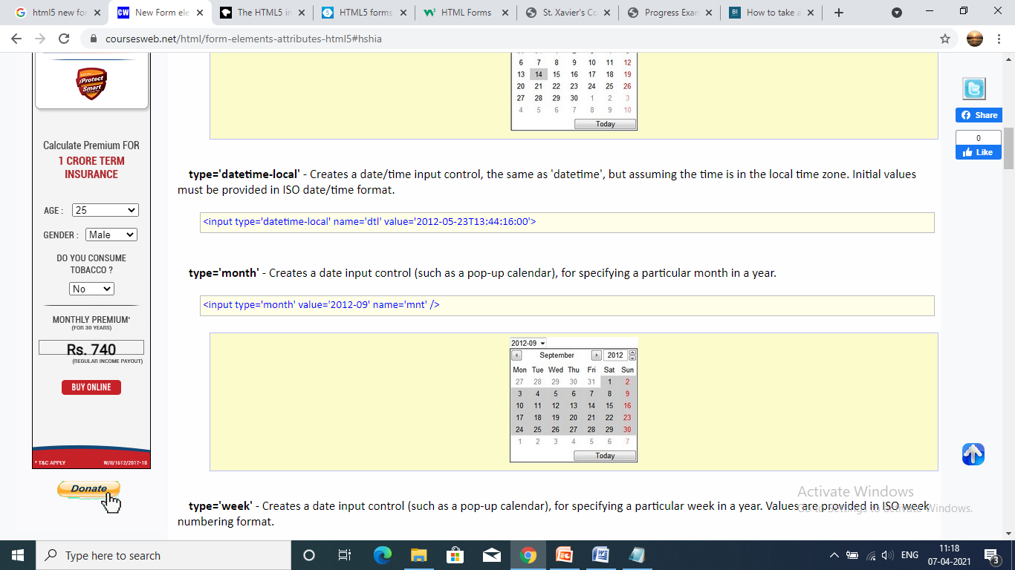
HTML5 Add on attributes to input type
type='date' - Creates a date input control, such as a pop-up calendar, for specifying a date (year, month, day). The initial value must be provided in ISO date format.
<input type='date' name='set_date' value='2011-10-15' />
type='datetime' - Creates a combined date/time input field. The value is an ISO formatted date and time that is defined and submitted as UTC time.
<input type='datetime' name='dt' value='2011-06-14T01:26:32:00Z' />
type='month' - Creates a date input control (such as a pop-up calendar), for specifying a particular month in a year.<input type='month' value='2012-09' name='mnt' />

Slide 34
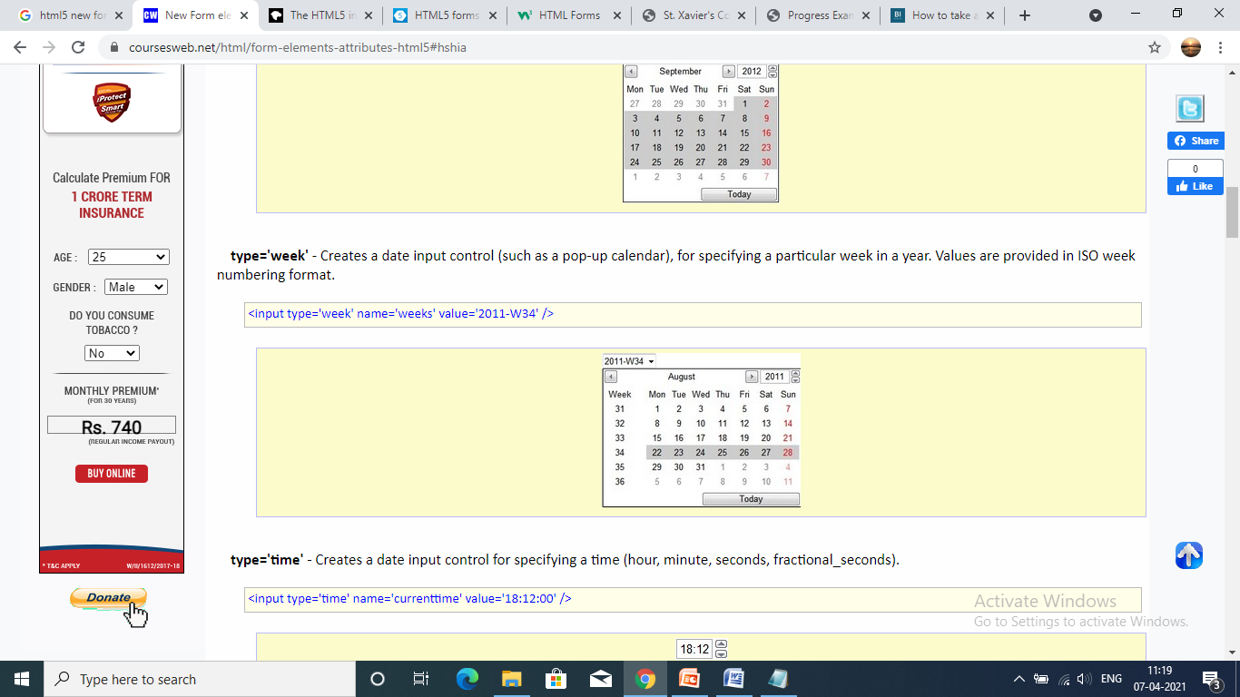
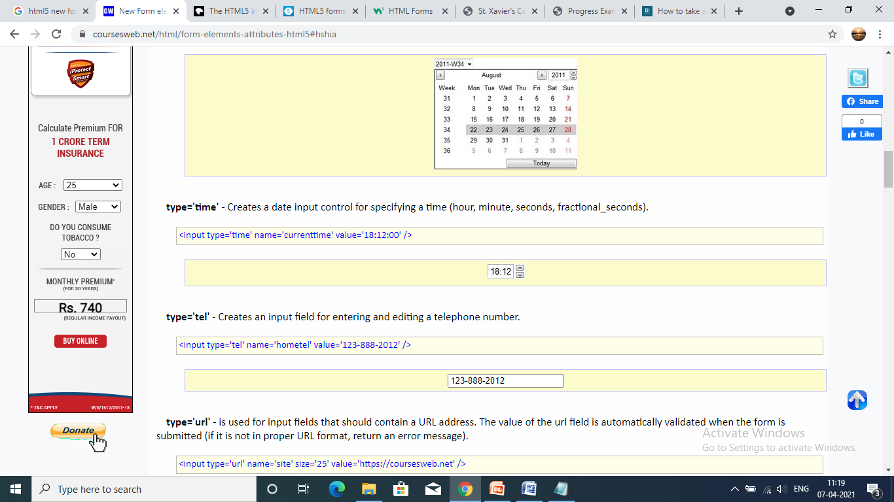
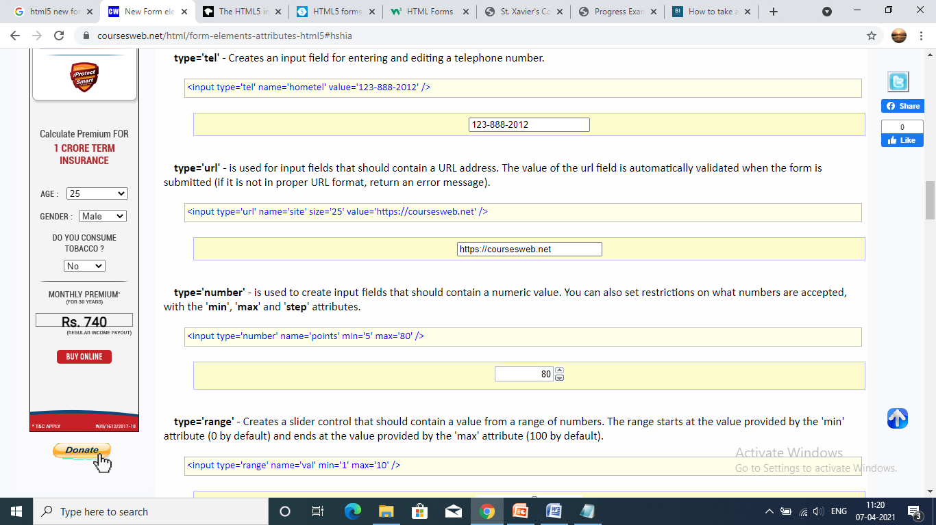
HTML5 Add on attributes to input type
type='week' - Creates a date input control (such as a pop-up calendar), for specifying a particular week in a year. Values are provided in ISO week numbering format.
<input type='week' name='weeks' value='2011-W34' />
type='time' - Creates a date input control for specifying a time (hour, minute, seconds, fractional_seconds).
<input type='time' name='currenttime' value='18:12:00' />
type='url' - is used for input fields that should contain a URL address. The value of the url field is automatically validated when the form is submitted (if it is not in proper URL format, return an error message).<input type='url' name='site' size='25' value='https://coursesweb.net' />

Slide 35
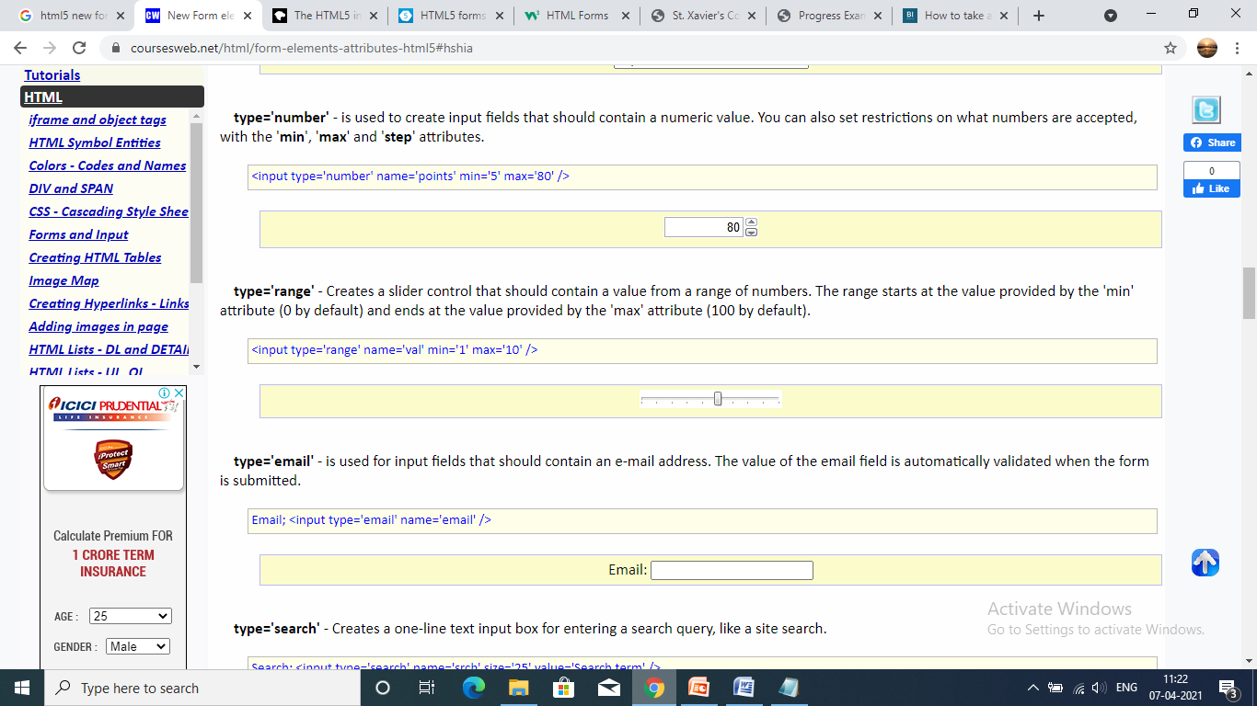
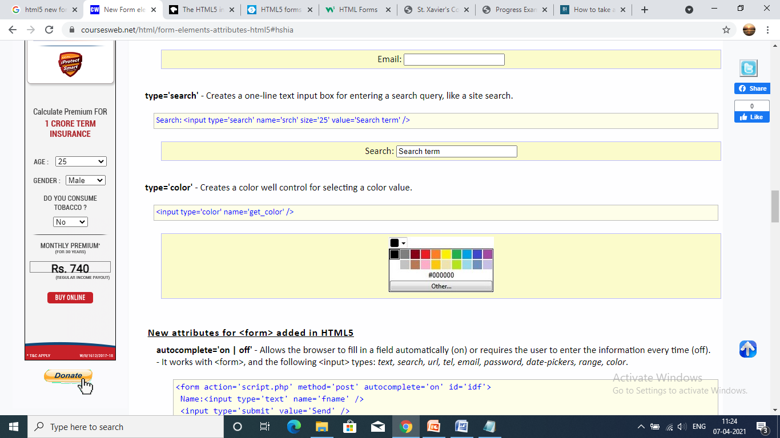
HTML5 Add on attributes to input type
type='number' - is used to create input fields that should contain a numeric value. You can also set restrictions on what numbers are accepted, with the 'min', 'max' and 'step' attributes.
<input type='number' name='points' min='5' max='80' />
type='range' - Creates a slider control that should contain a value from a range of numbers. The range starts at the value provided by the 'min' attribute (0 by default) and ends at the value provided by the 'max' attribute (100 by default).
<input type='range' name='val' min='1' max='10' />
type='email' - is used for input fields that should contain an e-mail address. The value of the email field is automatically validated when the form is submitted.
Email; <input type='email' name='email' />
type='search' - Creates a one-line text input box for entering a search query, like a site search.
Search: <input type='search' name='srch' size='25' value='Search term' />
type='color' - Creates a color well control for selecting a color value.<input type='color' name='get_color' />

Slide 36
HTML5 Add on attributes to input type="tel"
A special field for filling in phone numbers can be created using tel as the value of the type attribute:
<input type="tel" id="tel" name="tel">

Slide 37

<textarea>
It allows the user to enter multiple lines of text
It has an opening and closing tag, unlike most form elements.
A textarea has just a name, rows and cols (as in the number of rows of text, and the number of columns of characters in each row.)
You can also set wrap="virtual" if you don't want the text a user types to go outside the right side of the box.
A multi-line text field:
<textarea name="textarea" cols="24" rows="2">Hello</textarea>

Slide 38
Textarea - Attributes
NAME: name of this form field
COLS: how many characters wide
ROWS: how many rows
WRAP: how to wrap the text
READONLY: don't let the user change the contents of the field
DISABLED: don't let the user do anything with this field

Slide 39
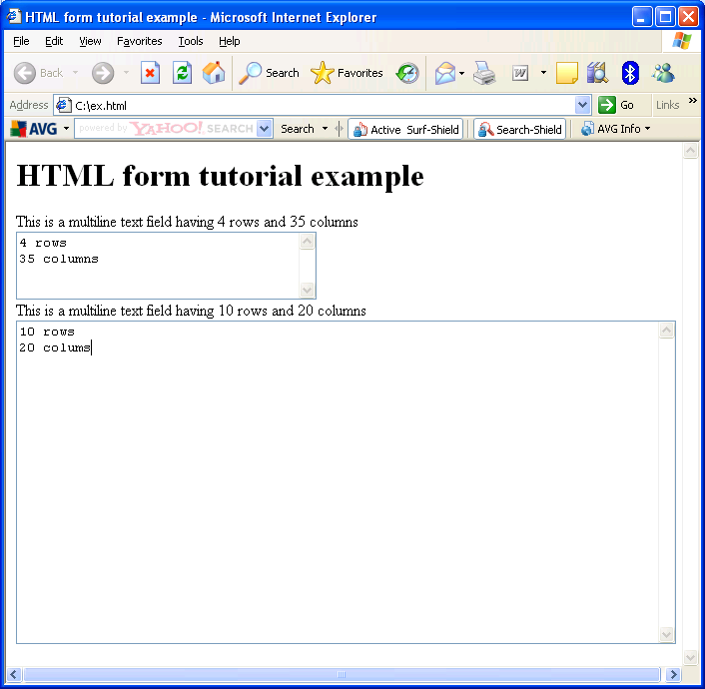
Example - textarea
<html>
<head><title>html form example</title></head>
<body>
<h1>HTML form tutorial example</h1>
<form>
This is a multiline text field having
4 rows and 35 columns<br>
<textarea name="body" cols="35“
rows="4" wrap="virtual">
4 rows
35 columns
</textarea>
<br>This is a multiline text field having
10 rows and 20 columns
<textarea name="lot" cols=20 rows=10>
10 rows
20 columns
</textarea>
</form>
</body>
</html>

Slide 40
<select> and <option> Tag
<select>... </select> shows a drop down box
Choices for the drop down box are created by using <option> tags
The text which follows <option> is displayed in the browser
Attributes of <option> tag
VALUE: indicates the value to be sent to the server.
SELECTED : indicates which option is selected by default

Slide 41
Select - Attributes
NAME: name of this form element
MULTIPLE: allow more than one choice. Can be done keeping the Control key pressed
SIZE: how many options to show. Default is 1
READONLY: don't let the user change the value of this field
DISABLED: don't let the user do anything with this field

Slide 42
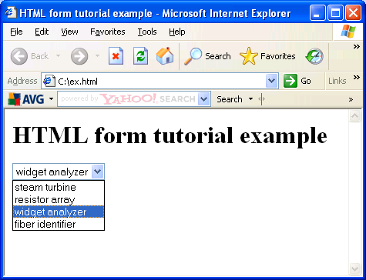
Example - Drop-down List
<HTML>
<HEAD><TITLE>HTML form tutorial example</TITLE></HEAD>
<BODY>
<H1>HTML form tutorial example</H1>
<form>
<SELECT NAME="partnumber">
<OPTION VALUE="7382" >steam turbine
<OPTION VALUE="2928" >resistor array
<OPTION VALUE="3993" SELECTED >
widget analyzer
<OPTION VALUE="9398" >fiber identifier
</SELECT>
</form>
</BODY>
</HTML>

Slide 43
New HTML5 attributes
pattern='regexp' - specifies a pattern (a regular expression) used to validate an input field. The 'title' attribute can be used with pattern to provide a description of the expected format of the input.
- It works with the following <input> types: text, search, url, tel, email, password The code below shows a text field that can only contain five characters (letters and numbers only):
<input type='text' name='pass' pattern='[A-z0-9]{5}' title='Five characters: letters and numbers' />

Slide 44
New HTML5 attributes
Placeholder='text' - Provides a short hint or example to help the user enter the correct data. (for a longer description, use the 'title' attribute). The hint is displayed in the input field when it is empty, and disappears when the field gets focus. - It works with the following <input> types: text, search, url, tel, email, password.
<input type='search' name='src' placeholder='Search CoursesWeb' />

Slide 45
New HTML5 attributes
required - indicates that an input field must be filled out before submitting. - works with the following <input> types: text, search, url, tel, email, password, date-pickers, number, checkbox, radio, file.
<input type='text' name='name1' required='required' />

Slide 46
New HTML5 attributes
max='number' - specifies the maximum value allowed for the input field. The 'max' value must not be less than the 'min' value.
min='number' - specifies the minimum value allowed for the input field.
step='any/number' - specifies the number intervals for the input field (if step='3', legal numbers could be -3,0,3,6, etc).
The 'min', 'max', and 'step' attributes works with the following <input> types: date-pickers, number, range. This code shows a field that accepts values between 1 and 10, with a step of 3 (legal numbers are 3, 6 and 9):
<input type='number' name='num' min='1' max='10' step='3' />

Slide 47
New HTML5 attributes
autofocus - specifies that a field should automatically get focus when a page is loaded. It workks in all <input>
fields.Name: <input type='text' name='name1' autofocus='autofocus' />

Slide 48
<output> </output> tag
Represents the result of a calculation, most likely the output of a script.
Total: <output name='total' onformchange='calc()'>0</output>

Slide 49
type="tel"
A special field for filling in phone numbers can be created using tel as the value of the type attribute:
<input type="tel" id="tel" name="tel">

Slide 50
Important reference :
https://developer.mozilla.org/en-US/docs/Web/HTML/Element/input

Slide 51
